Slide 1
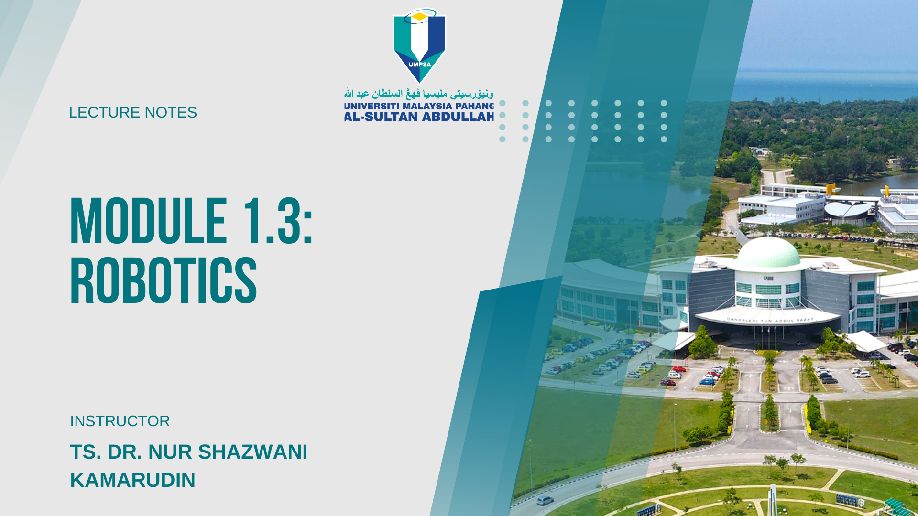

Slide 2

Learning Objectives
Robotics Timeline
Robot Classification
Definition of Robot
Robot Accessories
Robot Configuration

Slide 3
Robotics Timeline
1922 Czech author Karel Capek wrote a story called Rossum’s Universal Robots and introduced the word “Rabota”(meaning worker)
1954 George Devol developed the first programmable Robot.
1955 Denavit and Hartenberg developed the homogenous transformation matrices
1962 Unimation was formed, first industrial Robots appeared.
1973 Cincinnati Milacron introduced the T3 model robot, which became very popular in industry.
1990 Cincinnati Milacron was acquired by ABB

Slide 4
Robot Classification
The following is the classification of Robots according to the Robotics Institute of America:
Variable-Sequence Robot : A device that performs the successive stages of a task according to a predetermined method easy to modify
Playback Robot :A human operator performs the task manually by leading the Robot
Numerical Control Robot : The operator supplies the movement program rather than teaching it the task manually.
Intelligent Robot : A robot with the means to understand its environment and the ability to successfully complete a task despite changes to the environment.

Slide 5
Definition of Robot
Robotics Industry Association (RIA) - A re-programmable, multifunctional manipulator designed to move material, parts, tools or specialized devices through variable programmed motion for a variety of tasks
possess certain anthropomorphic characteristics:
mechanical arm
sensors to respond to input
Intelligence to make decisions

Slide 6
Robot accessories
A Robot is a system, consists of the following elements, which are integrated to form a whole:
Manipulator / Rover : This is the main body of the Robot and consists of links, joints and structural elements of the Robot.
End Effector : This is the part that generally handles objects, makes connection to other machines, or performs the required tasks.
It can vary in size and complexity from an end effector on the space shuttle to a small gripper

Slide 7
Robot Accessories
Actuators : Actuators are the muscles of the manipulators. Common types of actuators are servomotors, stepper motors, pneumatic cylinders etc.
Sensors : Sensors are used to collect information about the internal state of the robot or to communicate with the outside environment. Robots are often equipped with external sensory devices such as a vision system, touch and tactile sensors etc. which help to communicate with the environment
Controller : The controller receives data from the computer, controls the motions of the actuator and coordinates these motions with the sensory feedback information.

Slide 8
Robot Configurations
Some of the commonly used configurations in Robotics are
Cartesian/Rectangular Gantry(3P) : These Robots are made of 3 Linear joints that orient the end effector, which are usually followed by additional revolute joints.

